Slide 1
Requirements Document (full SRS)
By Luca Irimie, Sebastian Kuka
Paul Murariu, Leia Sayed
(Team 3)

Slide 2
Project Goals and Objectives
The primary goal of the VR Wheelchair Ping Pong software is to provide an immersive virtual reality experience for wheelchair users, enhancing accessibility and inclusivity in gaming. Objectives include:
Creating a realistic and responsive VR environment for wheelchair-based gameplay.
Developing AI-powered gameplay to provide a challenging opponent for players.
Ensuring high responsiveness for player controls to promote fluid gameplay.
Providing a customizable experience to accommodate a range of player abilities.

Slide 3
Statement of the Scope of the Project
The VR Wheelchair Ping Pong software is designed to simulate a table tennis match where a user in a wheelchair competes against an AI opponent. Major components include:
Inputs: VR controller movements for wheelchair navigation and paddle swings.
Processing Functionality: Real-time simulation of game physics, AI opponent responses, and scoring.
Outputs: Visual and audio feedback through VR, real-time score updates, and end-of-game results displayed to the player.
The SRS document as well as the presentation will not delve into specific implementation details but will instead focus on specifying the expected software functionality and behaviors.

Slide 4
Software Context
The VR Wheelchair Ping Pong game is part of an inclusive, accessible gaming product line. The software aims to fill a gap in VR gaming for wheelchair users by prioritizing accessibility. Strategically, it aligns with a broader industry trend toward VR applications that cater to diverse user needs, promoting both recreational and rehabilitative applications. This game also aligns with efforts to integrate AI technology in an interactive, supportive way, ensuring the AI opponent adapts to varied skill levels.

Slide 5
Major Constraints
Several constraints impact the software development, including:
Hardware Limitations: Compatibility with specific VR equipment and controllers, especially for accessibility-focused hardware.
Performance Requirements: The need for low latency to ensure real-time responsiveness in player controls.
AI Behavior Constraints: Ensuring AI does not display bias in gameplay, providing fair challenges that adapt to the player’s skill level.
Budget and Timeline: Limited resources for extensive user testing, necessitating efficient design and implementation processes.

Slide 6
User Profiles
This software serves different types of users, each with specific needs and expectations:
Primary Users:
Players with Limited Mobility: Individuals who rely on a wheelchair and want an engaging VR experience tailored to their needs.
Rehabilitation Patients: Users undergoing physical rehabilitation, where the game provides therapeutic benefits through engaging physical movement.
Secondary Users:
Rehabilitation Therapists: Professionals who use the software to support patient therapy and track progress.
Family and Supportive Personnel: People who assist primary users with setup and monitoring during gameplay.
Each user type will have different interaction levels with the software, from direct gameplay to monitoring and facilitating access.

Slide 7
User Stories
These user stories describe specific scenarios that define the use-cases for the VR Wheelchair Ping Pong game. They capture the needs and goals of different users in their own words:
As a player with limited mobility, I want to control my virtual wheelchair and paddle accurately using VR controllers, so I can fully participate in a realistic game experience.
As a rehabilitation patient, I want to play a VR game that helps me with my therapy exercises, allowing me to track my progress over time.
As a therapist, I want to set the difficulty level of the AI opponent based on my patient's current abilities, so the gameplay aligns with their therapeutic goals.
As a support person, I want an easy setup process for the VR game, allowing me to help the player get started with minimal effort.
These user stories are foundational for designing the software’s user interactions and ensuring that each user's needs are addressed in the game’s functionality.

Slide 8
Special Usage Considerations
Several special requirements must be taken into account for the VR Wheelchair Ping Pong game:
Accessibility: The software must include accessible controls for users with different levels of mobility, ensuring ease of operation and customization.
Safety: VR environments can disorient players, so safety features, such as clear boundaries within the VR space and easy exit options, are essential.
Therapeutic Tracking: For rehabilitation purposes, the software should record relevant gameplay data to allow therapists to monitor the patient’s progress.
AI Responsiveness: The AI opponent needs to adapt in real-time to provide a fair challenge without overwhelming or discouraging the player.
Performance Requirements: Ensuring low-latency control responses is critical to providing a seamless and immersive experience, as any lag in response could affect gameplay and usability.

Slide 9
Data Objects
Several special requirements must be taken into account for the VR Wheelchair Ping Pong game:
Player
Speed
Position
Move
Ball
Position
Speed
Gravity
Disappear
3. Paddle
Position
Swing speed
Bounce Strength
4. Opponent
Speed
Position
Move
5. Scoreboard
Position
Scores

Slide 10
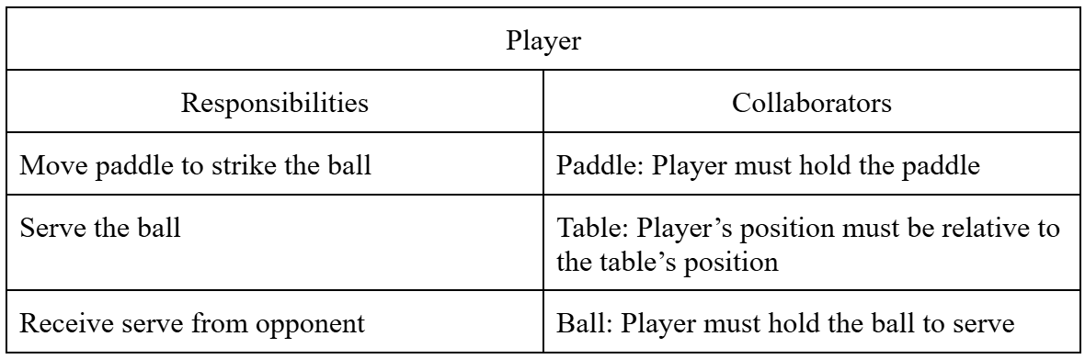
Data Relationships (CRC Cards)
Player Object Relationship:

Slide 11
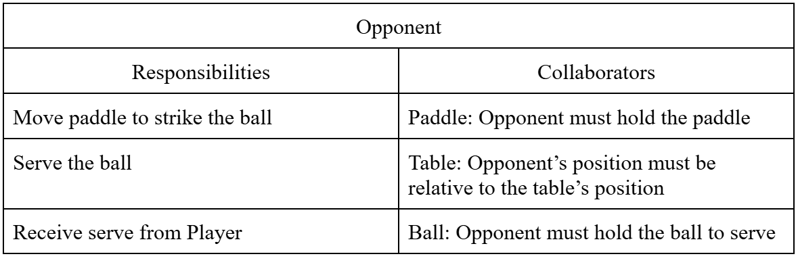
Data Relationships (CRC Cards)
Opponent Object Relationship:

Slide 12
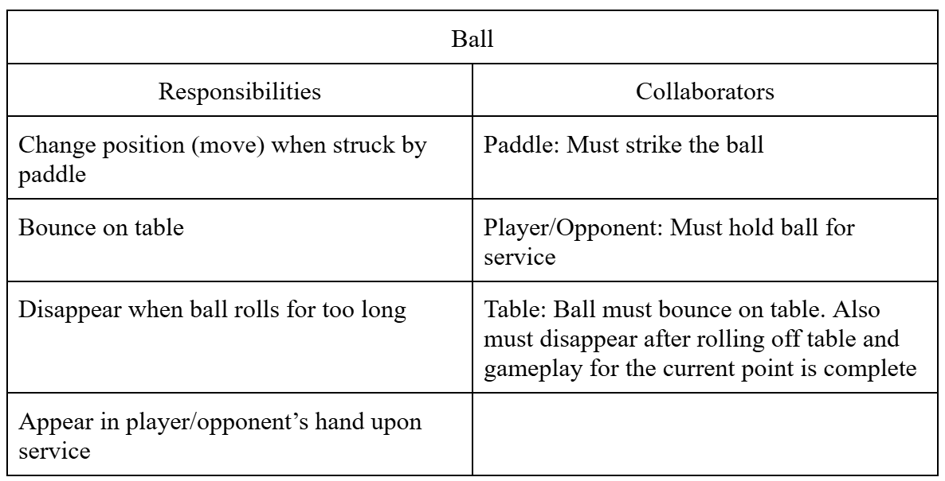
Data Relationships (CRC Cards)
Ball Object Relationship:

Slide 13
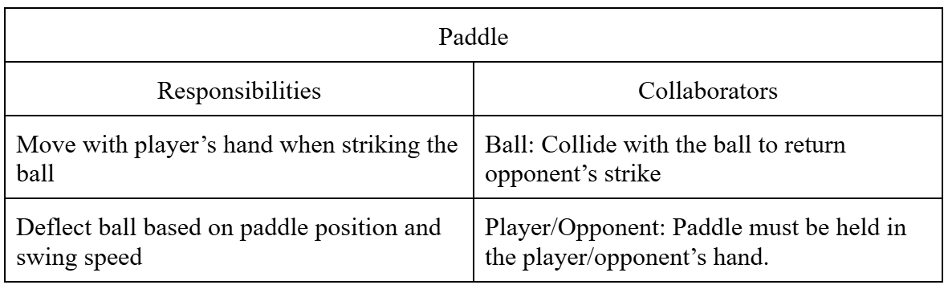
Data Relationships (CRC Cards)
Paddle Object Relationship:

Slide 14
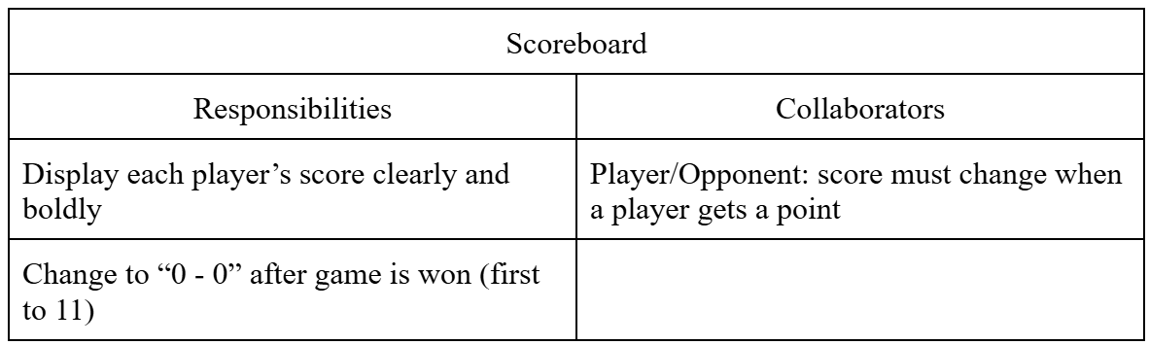
Data Relationships (CRC Cards)
Scoreboard Object Relationship:

Slide 15
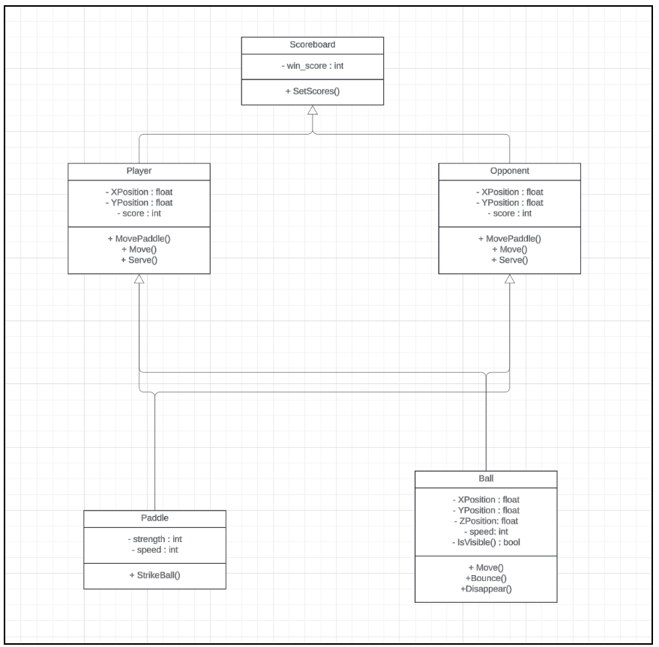
UML Class Diagram
Player and Opponent objects will both utilize functionalities from “Paddle” and “Ball” classes.
Scoreboard must take each player’s individual score in order to display correct value and determine “game over” condition.

Slide 16
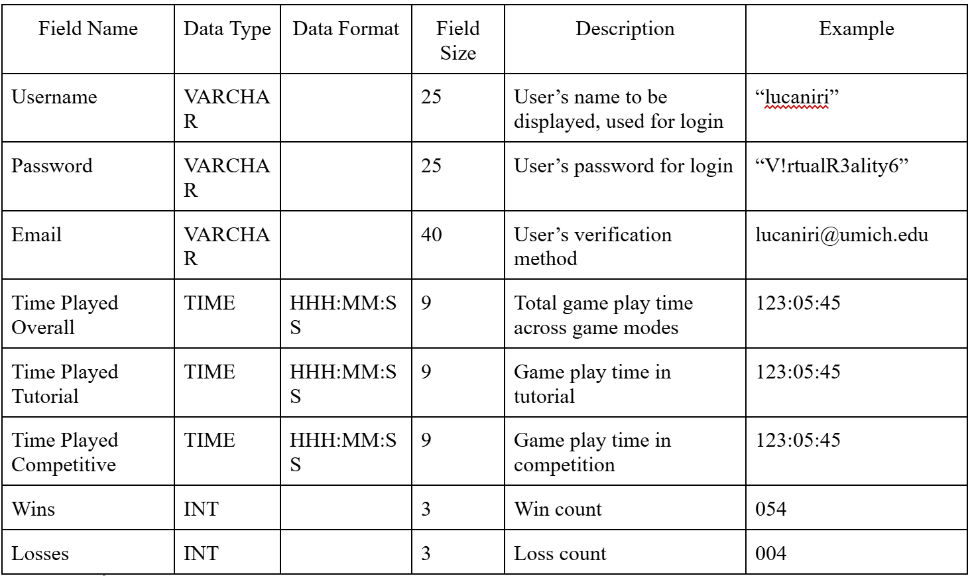
Data Dictionary
Note: Field sizes for VARCHAR attributes are arbitrarily determined.
Certain field values such as Time Played, Wins, and Losses should display when user navigates to statistics menu

Slide 17
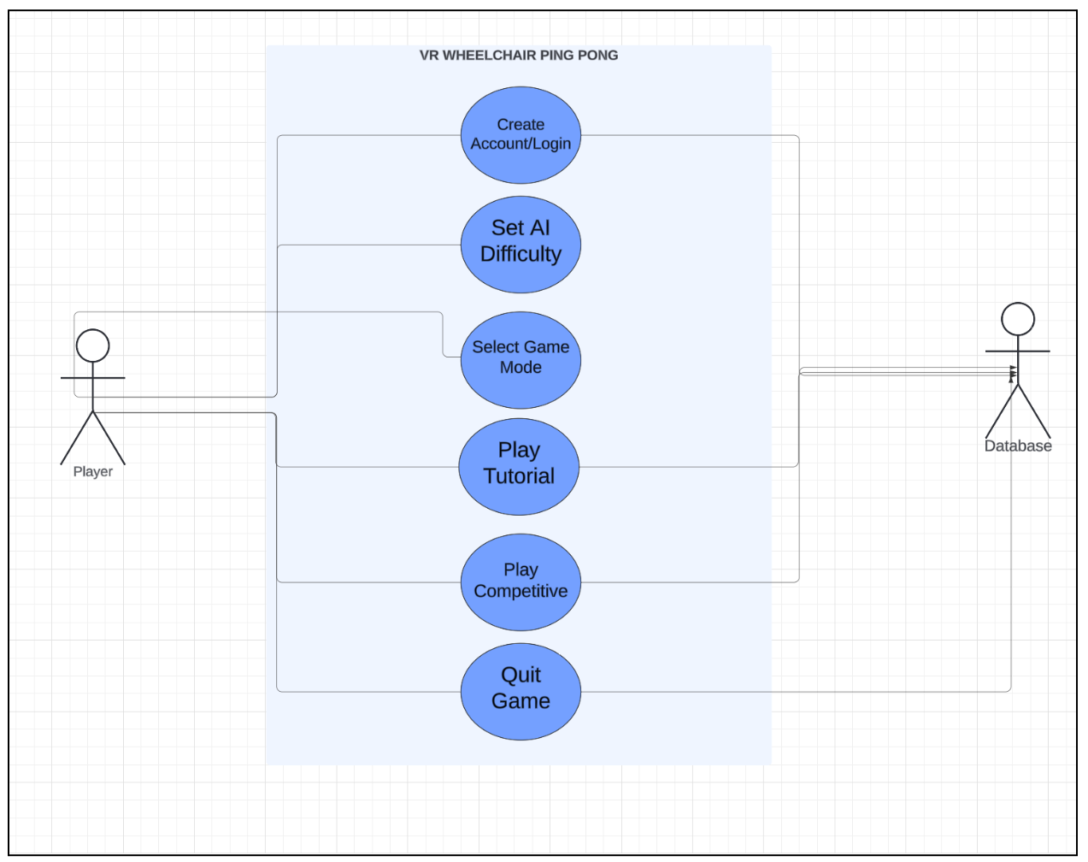
Use Case Diagram

Slide 18
Create Account/Login
RegisterPlayer()
Preconditions
Game Download
User must have the game downloaded and ready to play
Database Ready
The database must be live and ready to store player information
1.5 Scenario Description
Creating A Username
The player selects the “create an account” button. If the player already has an account, they will select the “login” button/prompt.
The player can create a username. If the username is already taken, go to alternate path 8.1. If the username is invalid, go to alternate path 8.2.
Once the username is validated, the credentials are sent to the database for storage.
Creating A Password
The player selects the “create an account” button. If the player already has an account, they will select the “login” button/prompt.
The player can create a password. If the password is invalid, go to alternate path 8.3.
Once the password is validated, the credentials are sent to the database for storage.

Slide 19
Create Account/Login (continued)
Post Conditions
Player Account Registration Complete
Duplicate Username
Invalid Username
Invalid Password
Exceptions
Duplicate Username
Invalid Username
Invalid Password

Slide 20
2. Setting AI Opponent Difficulty
SetDifficulty()
Preconditions
Game Download
Database Ready
4.2.5 Scenario Description
Setting AI opponent to “Easy”
The player selects the “create an account” button. If the player already has an account, they will select the “login” button/prompt.
The player can create a username. If the username is already taken, go to alternate path 8.1. If the username is invalid, go to alternate path 8.2.
Once the username is validated, the credentials are sent to the database for storage.
The user can select which type of game they wish to play, either tutorial or 1v1.
Upon selecting a game mode, the user can select “Easy” under “opponent difficulty”.
Based on the player’s selection, the “games played” and “games played against “Easy” AI” statistic is updated on the players profile and the database is updated.

Slide 21
2. Setting AI Opponent Difficulty (continued)
Setting AI opponent to “Hard”
The player selects the “create an account” button. If the player already has an account, they will select the “login” button/prompt.
The player can create a username. If the username is already taken, go to alternate path 8.1. If the username is invalid, go to alternate path 8.2.
Once the username is validated, the credentials are sent to the database for storage.
The user can select which type of game they wish to play, either tutorial or 1v1.
Upon selecting a game mode, the user can select “Hard” under “opponent difficulty”.
Based on the player’s selection, the “games played” and “games played against ‘Hard’ AI” statistic is updated on the players profile and the database is updated.
Post Conditions
“Easy”
“Hard”

Slide 22
3. Selecting Game Mode
SelectGameType()
Preconditions
Player must be registered/logged in to have the game fully loaded.
The database must be live and ready to retrieve/store player data (progress, AI settings, scores, etc.)
The player must have an active profile
4.3.5 Scenario Description
Setting Game Type to “Tutorial”
Player loads system, System checks if account is active. If not, player creates an account and game menu is presented after. If yes, game menu is presented immediately.
Game Type selection menu is presented to player.
Player selects “Tutorial” and is led to AI difficulty selection menu
System loads game
Setting Game Type to “Competition”
Player loads system, System checks if account is active. If not, player creates an account and game menu is presented after. If yes, game menu is presented immediately.
Game Type selection menu is presented to player.
Player selects “1v1” and is led to AI difficulty selection menu
System loads game.

Slide 23
3. Selecting Game Mode (continued)
Post Conditions
Player selects their AI Opponent difficulty.
Player successfully begins their selected game mode
Player begins the “Tutorial Gameplay” or “Competitive Gameplay” use case to control the wheelchair and paddle to play the game.
Player can initiate the “Quit Game” use case at any point to save their progress or exit.

Slide 24
4. Tutorial Gameplay
PlayTutorial()
Preconditions
Player Registration
Select Game Type
Scenario Description
The user selects “Tutorial” in the “Game Selection” menu.
The user enters the Tutorial mode and is met with the Tutorial mode playing environment.
The user starts by learning how to serve the ball.
The user then learns how to receive the ball.
The user practices the combination of these two mechanics.
Once the user is ready to exit, they pause then quit to title.
Database updates the user’s playing time in Tutorial mode
Post Conditions
Tutorial in Progress
Quit Gamemode

Slide 25
4. Tutorial Gameplay (continued)
Exceptions
Exit during tutorial
The user pauses the tutorial.
User selects the “Quit Tutorial” option.
User returns to the main screen.

Slide 26
5. Competitive Gameplay
PlayCompetitive()
Preconditions
Player Registration
Select Game Type
The player must choose a “Competitive” in the game selection menu.
Scenario Description
The user selects “Competitive” in the “Game Selection” menu.
The user enters the Competitive mode and is met with the Competitive mode playing environment.
The user starts by learning how to serve the ball.
The user then learns how to receive the ball.
The user practices the combination of these two mechanics.
Once the user is ready to exit, they pause then quit to title.
Database updates the user’s playing time in Competitive mode
Post Conditions
Competitive gamemode in Progress
Quit Gamemode
Exceptions
Exit during competitive
The user pauses the game.
User selects the “Quit Game” option.
User returns to the main screen.

Slide 27
6. Quit Game
QuitGame()
Preconditions
Active Game Session
Player Logged In
Scenario Description
Player initiates the Quit Game action
System prompts the player for confirmation
The game displays a confirmation prompt offering the player several options, such as:
Save and quit
Return to the main menu
Exit the game without saving
Player selects an option
System saves the player's progress (if chosen)
System safely exits the game or returns to the main menu
Post Conditions
Game Progress Saved
If the player chooses to save, the system ensures that the player's current game progress (score, settings, etc.) is saved in the database.
Game Properly Exited

Slide 28
6. Quit Game (continued)
Exceptions
Player cancels the quit action
If the player decides not to quit after being prompted, they can cancel the action and return to the game.
Save failure
If there’s an issue saving the game (e.g., database connectivity issue), the system displays an error message, and the player is prompted to retry or quit without saving.

Slide 29
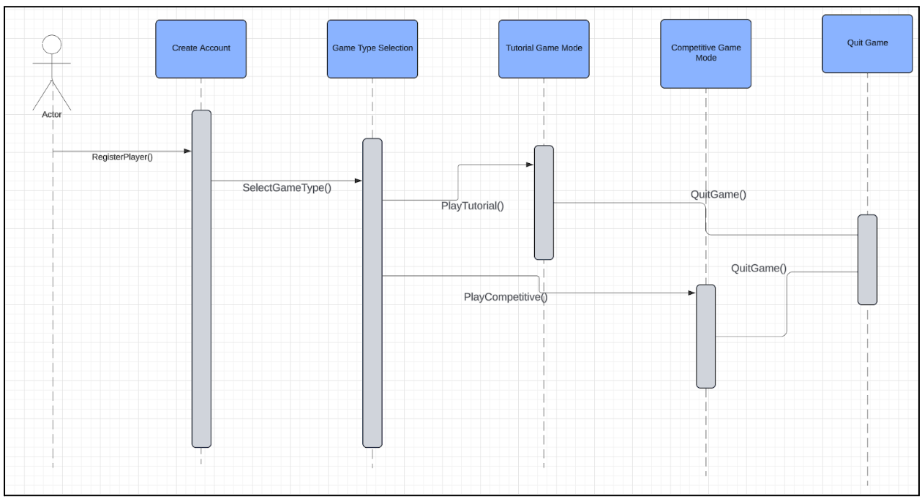
Sequence Diagram

Slide 30
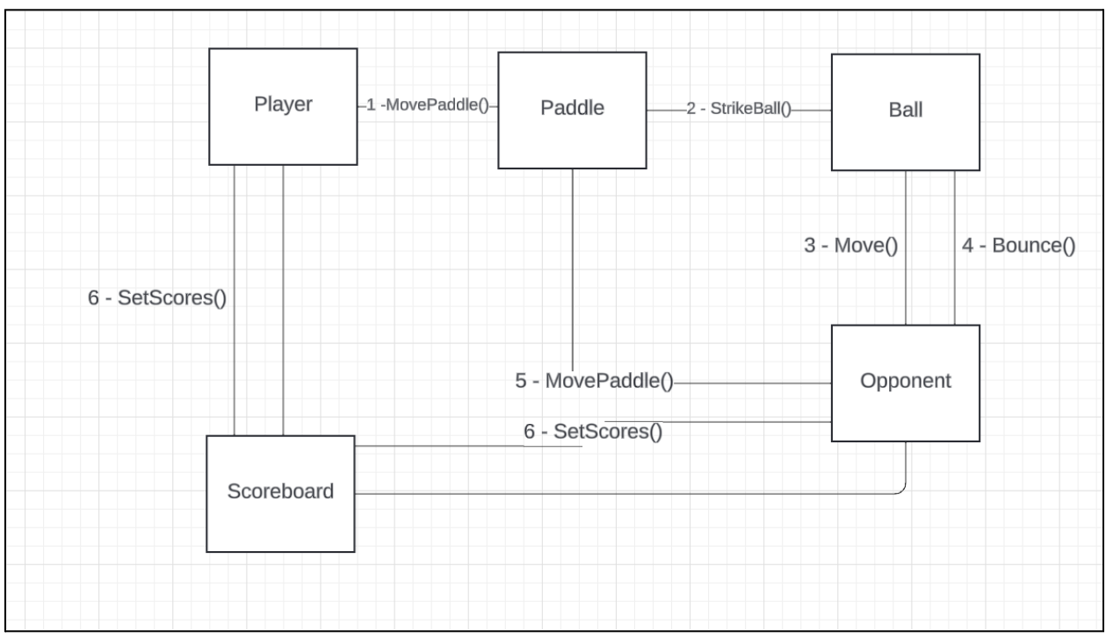
Communications Diagram

Slide 31
Behavioral Model
The VR Wheelchair Ping Pong game adapts gameplay based on user actions and system events.
Major focus on three parts of game
Player interactions
AI opponent responses
Environmental changes

Slide 32
Software Behavior Description
Player Controls:
Responds to VR controller inputs for wheelchair navigation and paddle swings.
Manages forward/rotational control, paddle positioning, and swing speed.

Slide 33
Software Behavior Description
AI Opponent Behavior:
Uses a finite state machine (FSM) for actions like intercepting the ball, adjusting swing speed, and responding to player movements.
Adjusts difficulty based on settings; engages in offensive and defensive playstyles.

Slide 34
Software Behavior Description
Game Events:
Includes ball collisions with paddles, table, and boundaries.
Tracks round/match outcomes, updates scores, and offers player options to continue or quit.

Slide 35
Events Triggering Behavioral Changes
Controller Input Events:
Player’s movement and swing actions.
AI State Transitions:
Changes in AI behavior based on FSM.
Scoring Events:
Updates upon points won or lost.
Game Mode Transitions:
Shifts between tutorial, competitive gameplay, and menu navigation.

Slide 36
Game States
Idle:
System waits for user input to start a game.
Gameplay:
Active state where player and AI interact.
Scoring:
Triggered when a player wins a point or is scored against
Pause:
Gameplay stops, waiting for player input to resume or quit.

Slide 37
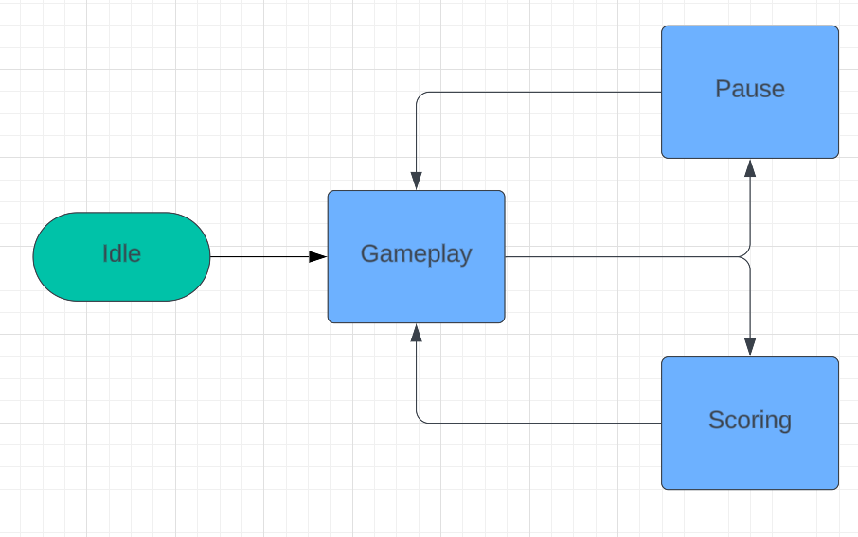
State Transition Diagram

Slide 38
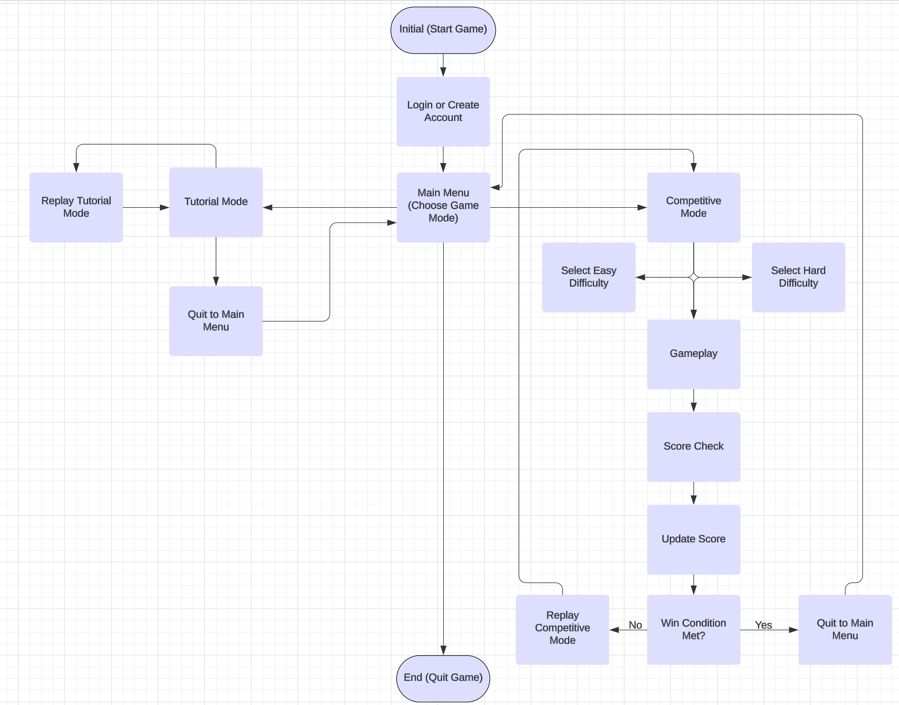
Activity
Diagram

Slide 39
Restrictions, Limitations, and Constraints
Hardware Constraints:
Designed for Oculus VR hardware; limited compatibility with other devices.
Performance Constraints:
Real-time response required to avoid delays in player input and AI reactions.
Must efficiently manage resources under high CPU/GPU loads.
AI Complexity:
AI difficulty restricted to predefined levels for balanced gameplay.

Slide 40
Restrictions, Limitations, and Constraints (cont.)
Accessibility Requirements:
Includes accessible control configurations; limited customization may impact some users.
Network Dependence:
Relies on cloud-based score tracking; offline functionality may be limited with unstable internet.
Development Timeframe:
Strict deadlines for prototype and final demo limit extensive user testing and refinement.

Slide 41
Validation Criteria: Test Classes
Functional Testing:
Gameplay Mechanics: Ensures the VR controls are correctly mapped to wheelchair movement and paddle swings.
AI Opponent Functionality: Ensures that the AI opponent adjusts difficulty based on settings, is not overly biased, and behaves fairly.
Menu/Game-Screens: Ensures that there is smooth navigation through menus, game modes, and settings.

Slide 42
Validation Criteria: Test Classes (Cont.)
Accessibility Testing:
Controller Responsiveness: Controls are adaptable and responsive for all mobility needs.
Game Screen Accessibility: Visual and auditory feedback makes game activities clear to all players.

Slide 43
Validation Criteria: Test Classes (Cont.)
Performance Testing:
Latency & Frame Rate: Confirming player input is processed with little to no delay, prevents motion sickness.
Compatibility & Reliability Testing: Ensures compatibility with Oculus VR systems and stability for different use cases including saving, quitting, and reloading game states.
Usability: Focuses on the user experience and ensures that there are intuitive controls and easy gameplay for users of all kinds.

Slide 44
Expected Software Response
Functional Testing: Game should perform all required functions accurately and respond to user input accordingly.
Accessibility Testing: All players, regardless of mobility, should find the game controls and actions responsive for enjoyable gameplay.
Performance Testing: Input latency should be less than 35ms and frame rate should remain consistent across entirety of game.

Slide 45
Expected Software Response (Cont.)
Compatibility & Reliability Testing: Game should run smoothly on Oculus VR systems and retain user data & settings to allow for seamless transition between gaming sessions without any loss/corruption.
Usability: Player experience should ensure intuitive controls and feedback, minimal setup, and should be straightforward.

Slide 46
Performance Bounds
Latency: User input latency should be less than 35 ms to ensure a consistent gameplay experience.
Frame Rate: Game should maintain a consistent frame rate to ensure smooth play and avoid VR motion sickness.
AI Opponent Decision Making: AI opponent decision making should not be delayed longer than 10 ms to maintain foundation of real-time interaction.
Memory Usage: Game should not exceed 75% of the Oculus’ available memory to prevent crashes and ensure reliable performance.

